Slide 1
Data Science HW2
3/30(Tue) 23:59 ~ 4/13 (Tue) 23:59

Slide 2
Target
Given transactions, min support, implement algorithms to find the frequent patterns
Use python3/C++
Use any algorithms, include Apriori、FP Growth...etc.

Slide 3
Input
A txt file include transactions
Items will be represented as indexes (range from 0 to 999)
At most 100000 transactions
Every line represent a transaction, there would be ‘,’ between items in transactions

Slide 4
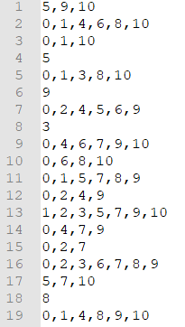
Input
Eg: sample.txt

Slide 5
Output
Output a txt file
One line is one set of frequent pattern
frequent pattern would be followed by a ”:” and the support
Frequent pattern ordered from fewer items ones to greater ones , if the item number are the same, the smaller index ones would in front of bigger ones
Items in every frequent pattern would follow ascending order by index
Round Support to the fourth decimal place after comparison

Slide 6
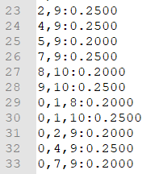
Output
Eg : sample.txt (min support = 0.2) output file
sample_out.txt

Slide 7
Notice
Use C++/python3
Name your file as YourStudentID_hw2.cpp/YourStudentID_hw2.py
You should enter 3 parameters in order : min support, input file name, output file name
C++ execute method
compile: g++ -std=c++11 -o YourStudentID_hw2 YourStudentID_hw2 .cpp
Execute: ./YourStudentID_hw2 [min support] [InputFileName] [OutputFileName] (windows environment : YourStudentID_hw2.exe [min support] [InputFileName] [OutputFileName])
Ex: ./12345_hw2 0.2 input1.txt ouput1.txt

Slide 8
Notice
Python
Execute: python3 YourStudentID_hw2.py [min support] [InputFileName] [OutputFileName]
Using apyori、pyfpgrowth ... Package in python is forbidden

Slide 9
Grading Policy
There would be 5 testcases
Your grade would according to the number of testcases you pass
You’ll get points only if your output file is completely correct
(0, 60, 70, 80, 85, 90/95/100)
Point of the last testcase would be grade according to the speed, top 33% would get 15 points, middle 33% would get 10 points, last 15% would get 5 points

Slide 10
Grading Policy
 |  | TA Fp Growth (C++) | Time limit
Testcase 1 |  | <1 sec | 60 sec
Testcase 2 |  | 2 sec | 60 sec
Testcase 3 |  | 10 sec | 100 sec
Testcase 4 |  | 37 sec | 150 sec
Testcase 5 |  | 230 sec | 480 sec

Slide 11
Submit and Execute Environment
Choose C++/python3 to complete your hw, submit it to ILMS
(YourStudentID_hw2.cpp/YourStudentID_hw2.py)
Environment
OS: Ubuntu 16.04.5 LTS
gcc vesion: 5.4.0
Python version: python 3.7.9

Slide 12
GCC in windows

Slide 13
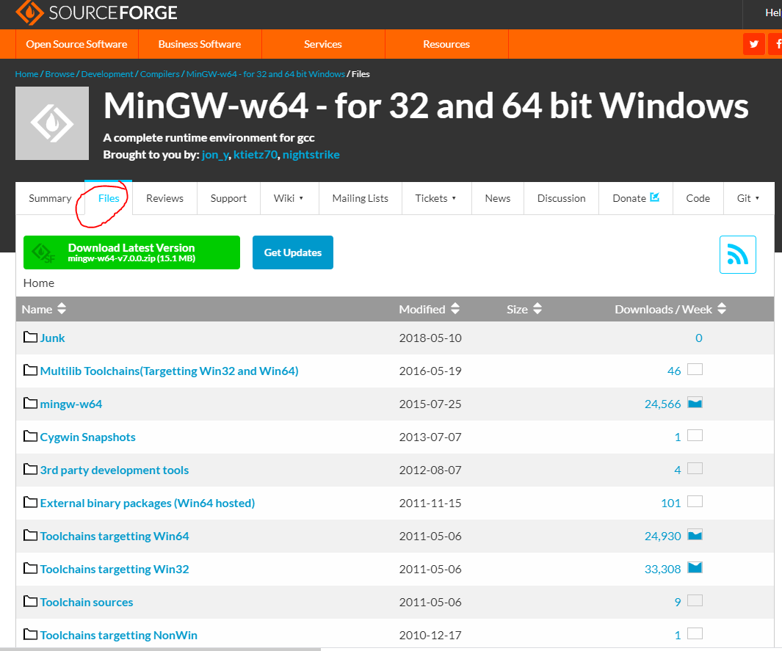
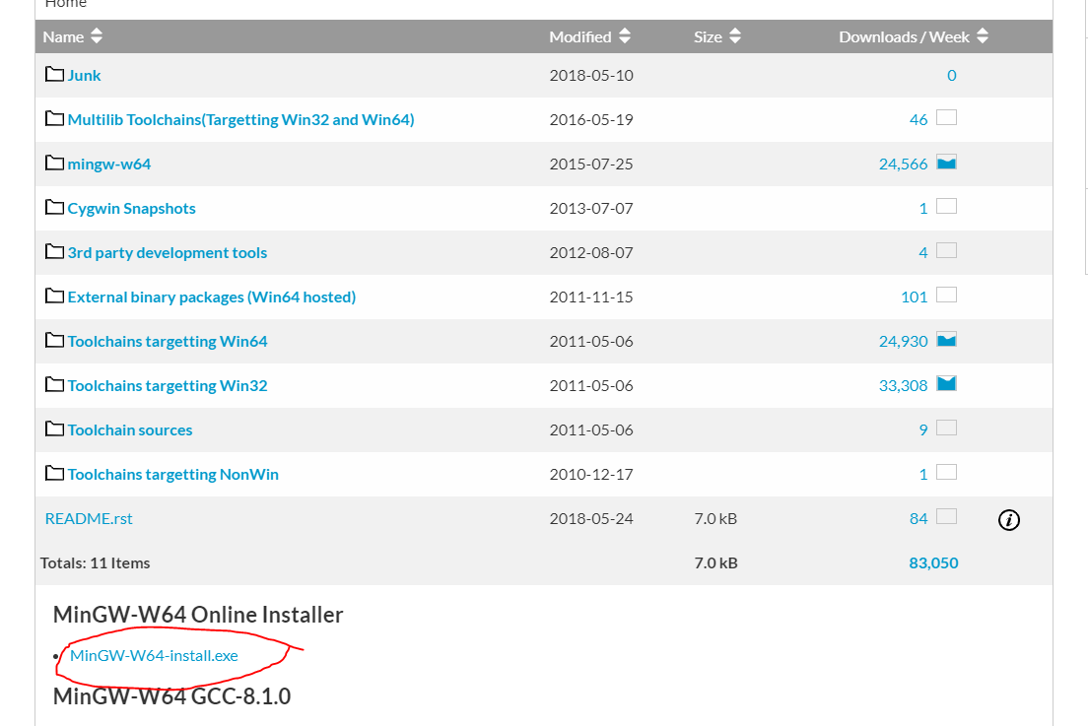
In Windows (Step 1)
Download the compiler installer
https://sourceforge.net/projects/mingw-w64/

Slide 14
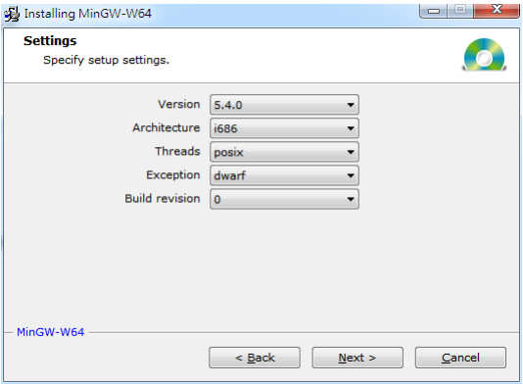
In Windows (Step 2)
Select gcc version 5.4.0 and i686 architecture

Slide 15
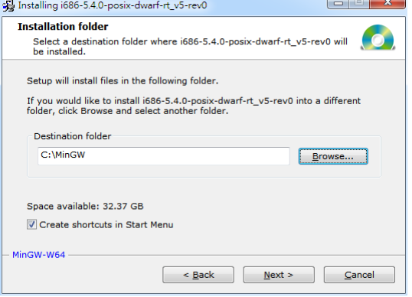
In Windows (Step 3)
Install the compiler to C:\MinGW

Slide 16
In Windows (Step 4)
Computer [right button]->Properties
- >Advanced system settings- >Advanced->Environment Variables
-> System Variables->Path->add the instruction C:\MinGW\mingw32\bin;
Now you can use g++ in cmd

Slide 17
